Slide 1
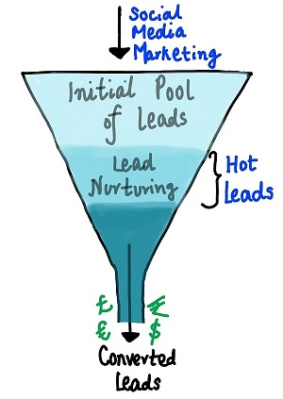
LEAD SCORING CASE STUDY
Submitted by : Snigdha Chakraborty
Abhijith Desai

Slide 2
Business Problem Statement
An education company named X Education sells online courses to industry professionals. On any given day, many professionals who are interested in the courses land on their website and browse for courses
The company markets its courses on several websites and search engines like Google. Once these people land on the website, they might browse the courses or fill up a form for the course or watch some videos. When these people fill up a form providing their email address or phone number, they are classified to be a lead. Moreover, the company also gets leads through past referrals. Once these leads are acquired, employees from the sales team start making calls, writing emails, etc. Through this process, some of the leads get converted while most do not. The typical lead conversion rate at X education is around 30%
X Education has appointed you to help them select the most promising leads, i.e. the leads that are most likely to convert into paying customers. The company requires you to build a model wherein you need to assign a lead score to each of the leads such that the customers with higher lead score have a higher conversion chance and the customers with lower lead score have a lower conversion chance. The CEO has given a ballpark of the target lead conversion rate to be around 80%

Slide 3
Technical Approach
Data Understanding
Data Cleaning
Exploratory Data Analysis
Data Preparation
Final Analysis and Conclusion
Model Evaluation Metrics
Model Prediction on Test
Model Building, ROC Curve

Slide 4
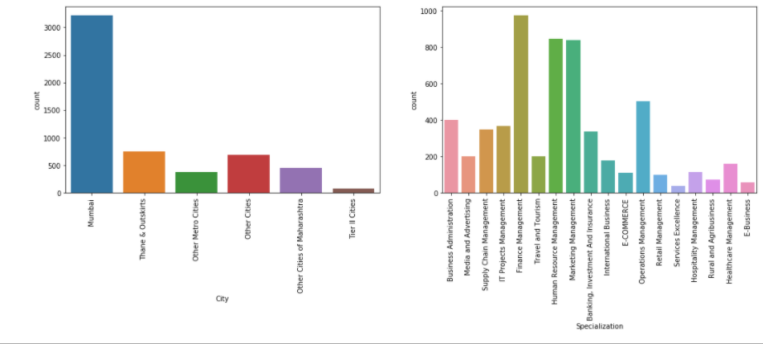
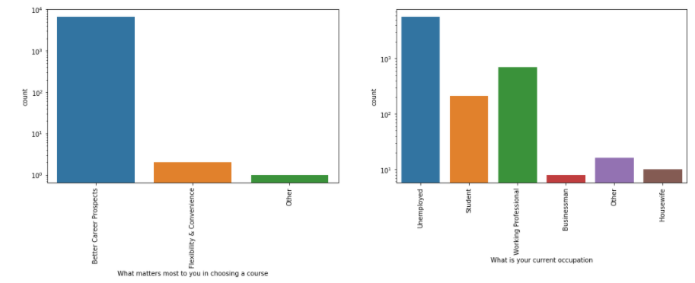
Data Understanding and Cleaning
There were ‘Select’ values in many columns which were as good as Null. Hence, replaced with NaN
The Columns with >= 40% and rows with <=1% of missing values were dropped
For others missing values were checked and Imputed using mean/median for numerical and mode for categorical variables such as ‘City’, ‘Specialization’ and so on. Some are shown here: -
Low frequency items were merged into derived col as ‘Others’
Post cleaning of data, We moved with 98.2% of original rows for EDA

Slide 5
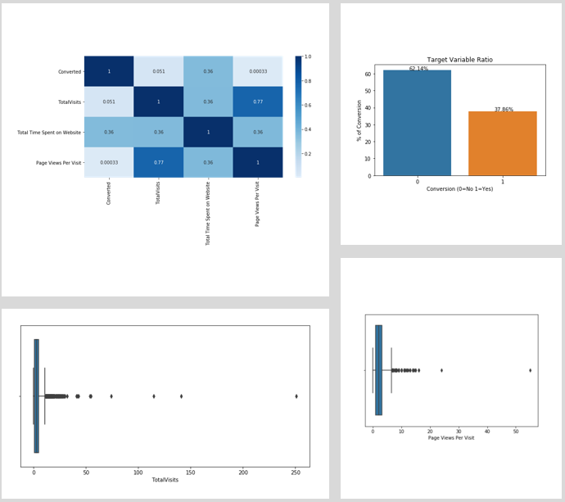
Exploratory Data Analysis
As part of Data Imbalance check we observed that target variable ratio is 62:38 i.e., ~38% of conversion is available. Hence, data is balanced
Heat Map helped to confirm correlation
Univariate and Bivariate used for data spread analysis and relation with target variable
Outliers were detected and handled using soft capping at 5% and 95%
Based on the EDA and data inspection we concluded that there are columns not adding any information to the model, hence we can drop them for further analysis
After all the process of data cleaning we managed to retain 98% of data which is good for model building

Slide 6
Data Preparation
Dummy variables were created for categorical values
Variables with binomial values were converted into 0 and 1
The data was split into train - test
Numerical Features of training dataset were scaled using standardized scaler
The train data was scales using fit_transform()
The test data was split using transform()
The model building was started with final 58 variables

Slide 7
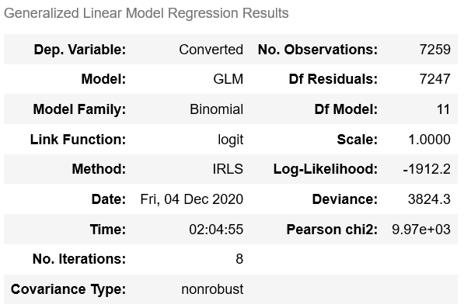
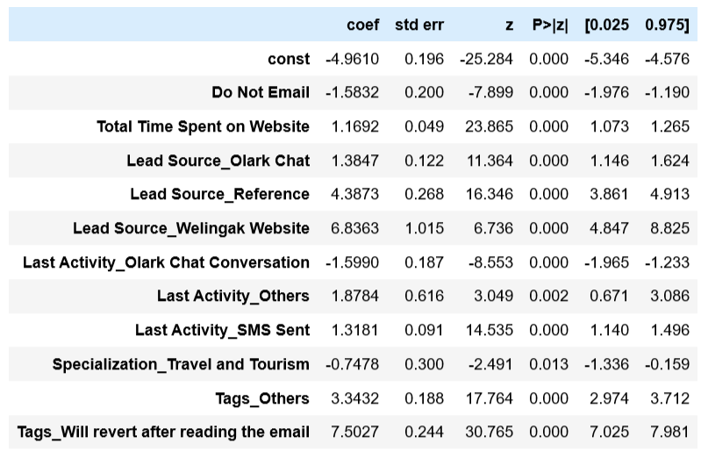
Model Building (RFE)
Initial Model was build using all features, but stats represented that there were many in-significant variables
Hence, used RFE to select top 18 variables to start our first model
With consecutive iteration variables with high p-value >=0.05 and VIF (highly correlated) were subsequently dropped from model building
Final model was built with 11 variables with VIF and p-value in accepted range
Prediction was done with 1 if prob >=0.5 else 0
The model gave an overall accuracy of 89%, sensitivity = 82% and specificity = 93%

Slide 8
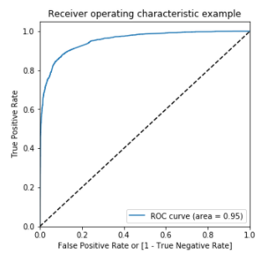
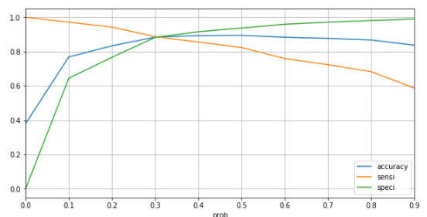
ROC and Optimal Cut-Off
ROC shows the tradeoff between sensitivity and specificity (any increase in sensitivity will be accompanied by a decrease in specificity)
The closer the curve follows the left-hand border and then the top border of the ROC space, the more accurate the test
The closer the curve comes to the 45-degree diagonal of the ROC space, the less accurate the test
Optimal cutoff probability is that prob where we get balanced sensitivity and specificity
From the curve, 0.3 is the optimum point to take it as a cutoff probability
ROC Curve area = 0.95 indicates an accurate model build

Slide 9
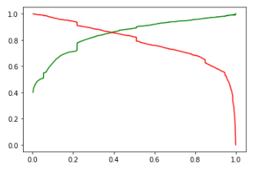
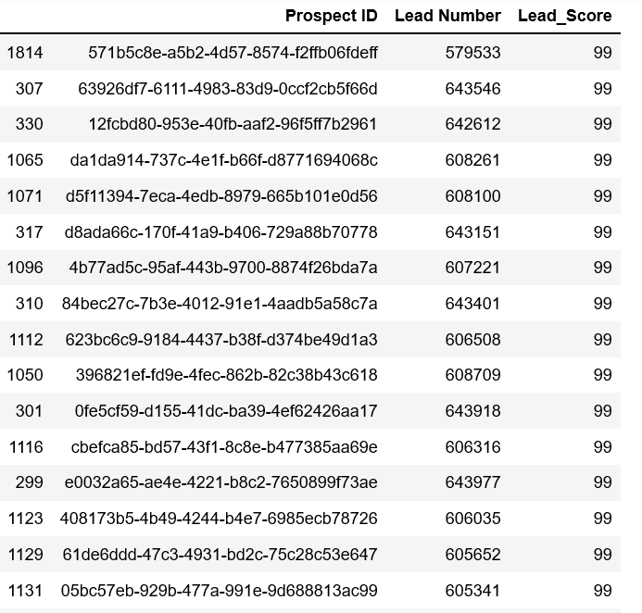
Predictions and Model Summary
Final model with optimal threshold gave us following performance matrix
85% of Recall value indicates that our model can predict 85% of actual conversion cases correctly
83% of Precision value indicates that 83% of the conversions that our model predicted is converted
Assigned Lead score will help to maximize the lead conversion by choosing high lead score value
The score will also help sales team to decide conversion techniques as per their business needs
 | Accuracy | Sensitivity/ Recall | Specificity
Test | 87.93 | 85.42 | 89.44
Train | 88.43 | 88.72 | 88.25

Slide 10
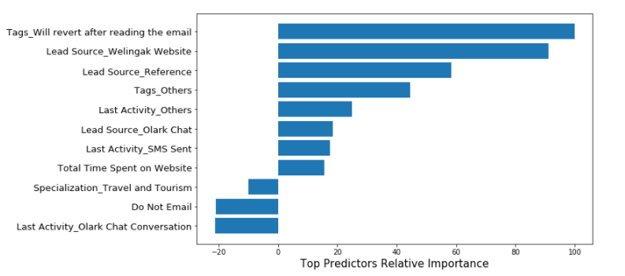
Top features for Potential Leads
Top predictors based on their relative coefficient values :-
Tags
Will revert after reading the email, Others
Lead Source
Welingak Website, Reference, Olark Chat
Last Activity
Others, SMS Sent, Olark Chat Conversation
Total Time Spent on Website
Specialization
Travel and Tourism
Do Not Email
Top 3 variables for potential conversion:-
Tags_Will revert after reading the email
Lead Source_Welingak Website
Lead Source_Reference

Slide 11
Conclusion
The model helped us to achieve a target lead conversion rate > 80%
Interpretation using Log Odds: -
We can also use Log Odds formula along with our final model variable coefficients to find conversation state of any new leads
Log Odds Formula →
ln(P1-P) = β0X0 + β1X1 + β2X2 + ……………. + βnXn
Where:
Β0, β1, β2 ……. are coefficient and
X1, X2, X3 ……. are respective variables

